Slide 1

LOGO
Machine Learning Final Project
(Gary Har)

Slide 2
Introduction
Problem statement :
The number of customers using the banking services has declined, and the bank is worried that existing customers have stopped using them as their main bank.
Action Plan :
Identify which factors contribute to customer churn and develop a prediction model to predict customer churn.

Slide 3
Data Exploration - Data dictionary & size
Data size
Total of 10,000 rows and 12 columns
Target (y)
Exited: Whether customer has churned (1 is yes)
Features (X)
CustomerID: Unique ID of each customer
CredRate: Credit Score of the customer
Geography: Country customer is from
Gender
Age
Tenure: How long customer has been with bank
Balance: customer savings has/had with the bank
Prod Number: Number of products customer has with bank
ActMem: wheather customer was actively engaged with the bank activities (1 is yes)
Estimated salary: Annual estimated salary of customer
HasCrCard: Does customer have credit card

Slide 4
Data Exploration – Data pre-processing
A) Missing value handling
Feature’s name / Amount Solution
1) Gender / 4 Remove all the rows since the amount is very minimum
2) Age / 6 Replace with mean value since the data distribution is quite balance
3) EstimatedSalary / 4 Replace with mean value since the data distribution is quite balance
B) One Hot encoding
Found Geography and Gender columns under object type, will need to convert it from categorical
value to numerical value as the machine learning algorithms require that input and output variables
are numbers.
Data scaling
Found multiple features’ value spanning varying degrees of magnitude, will use standardization
scaling method to puts all data into the same range and on the same scale for machine learning
algorithms.

Slide 5
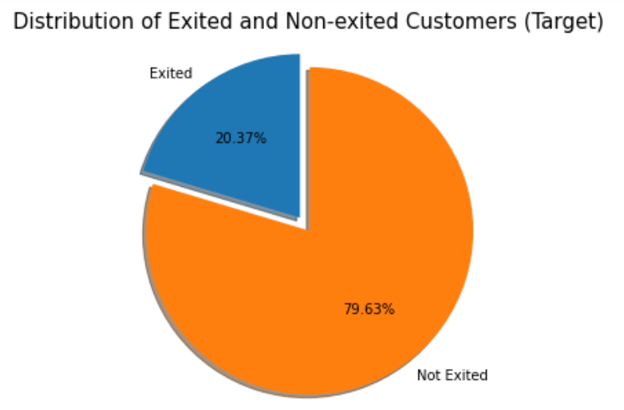
Data Exploration – Data visualization & analysis
👀 Values distribution in the target column are relatively imbalanced.

Slide 6
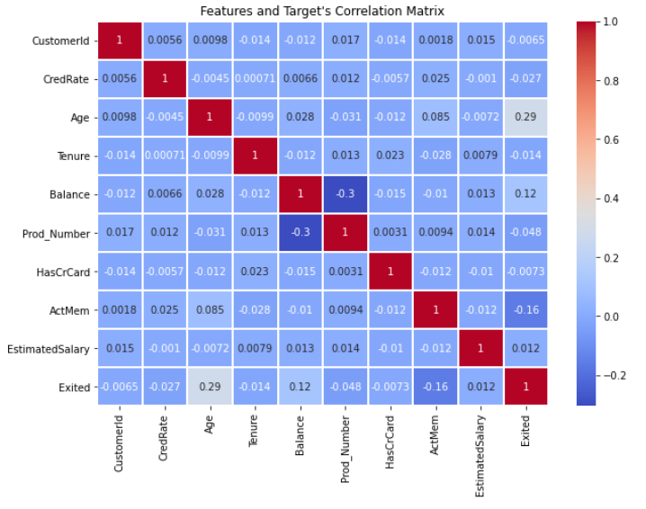
Data Exploration – Data visualization & analysis
👀 The above results show that there are very minimum correlations between the variables in the data set. The closest correlation amongst the variables are Prod_Number and Balance, which make sense that higher savings' group of customer might have better capacity to engaged with more products or services offered by the bank.
On the other hand, CustomerId and HasrCrCard shows lowest correlationship with the target (Exited). CustomerId will consider as uninformative feature in this case. But for HasCrCard, it depend on the nature of data provided wether it depicts only the customer has credit card within the bank or can be with other bank also. In this case, the second screnario is lightly to be higher.

Slide 7
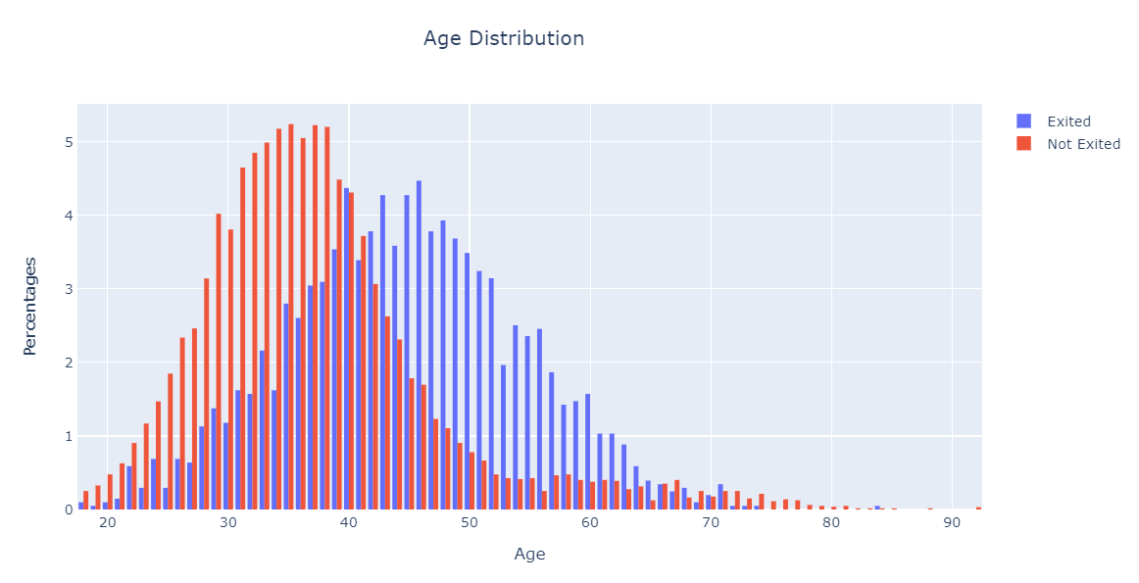
Data Exploration – Data visualization & analysis
👀 As Observed, number of customers who stay with the bank decreases as the ages are increasing. Especially in the range starting from ages 37 to 52 years old, the number of customers exited the bank is maintained at a higher level with an average of 3% and above as compared to the other ages. A Total of 59.08% out of the total exited customers are derived from the above mentioned range of age. It can be due to the reason of an increasing amount in demand for a more comprehensive product or services relative to the change in the different stages of life, however, other banks might be offering a better or more appropriate product or service to them instead. Hence, it causes an increasing amount of exited customers in this range.

Slide 8
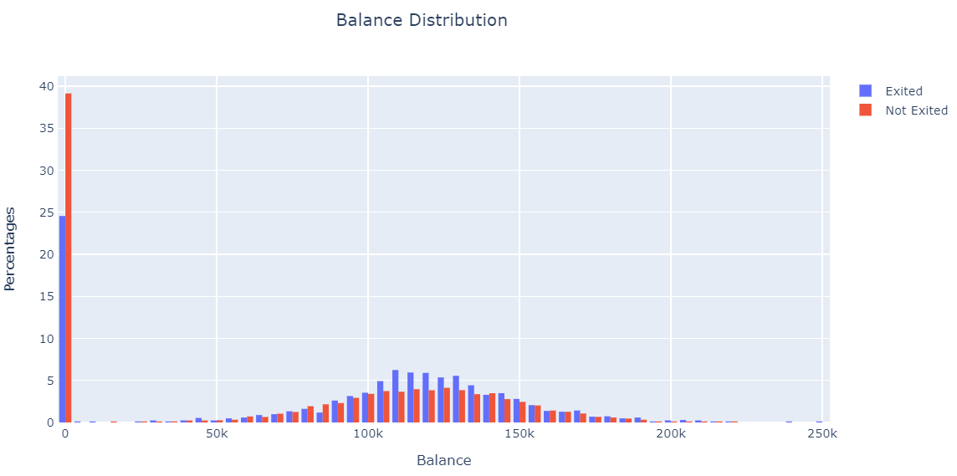
Data Exploration – Data visualization & analysis
👀 As Observed, there are 2 groups of the customer in Balance that makeup of 73.12% in the total exited amount. The very first group are customers who have zero savings with the bank, which shows 24.5% out of the total. The second group are customers who have savings with the bank ranging from 97.5k to 147.5k, which shows 48.62% out of the total.

Slide 9
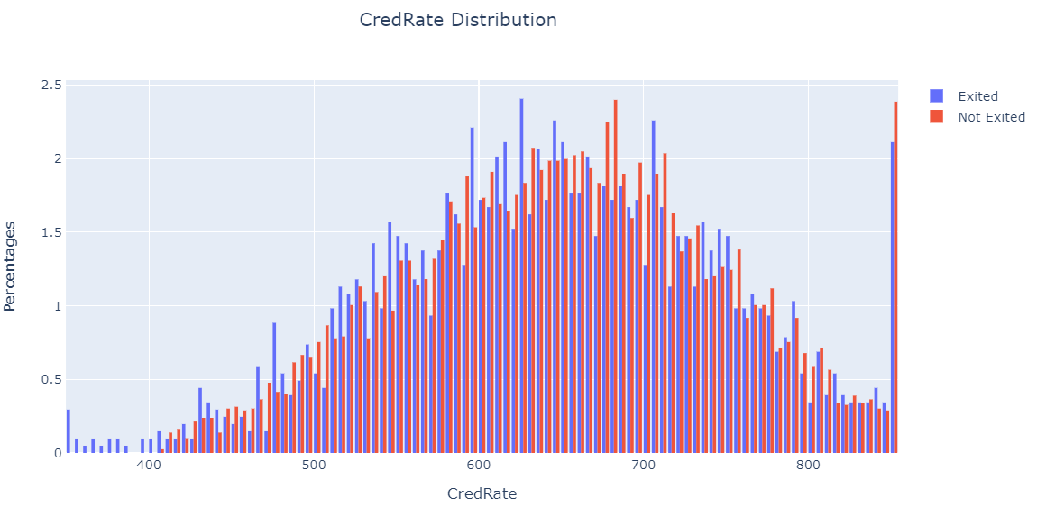
Data Exploration – Data visualization & analysis
👀 As Observed, more than half (51.86%) of the exited customers in CredRate are falling in the range of 550 to 700 credit score. Other than the above-mentioned group of customers, those who have a credit score of less than 400 tend to also leave the bank.

Slide 10
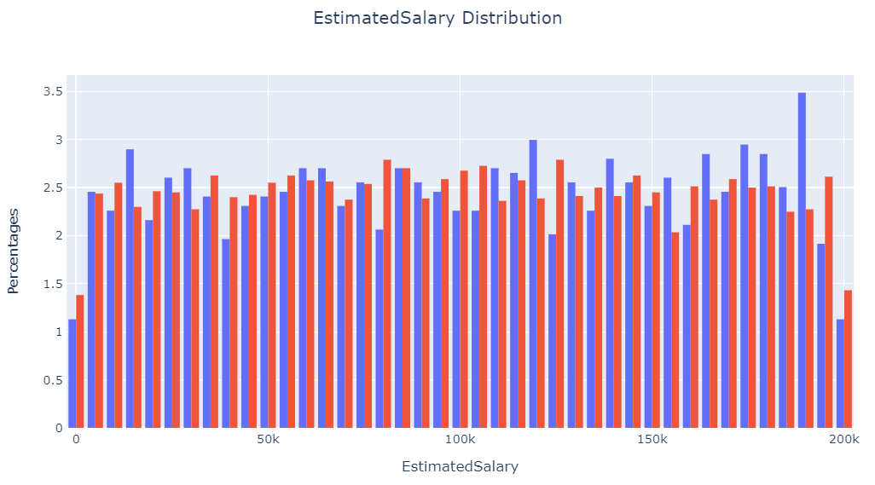
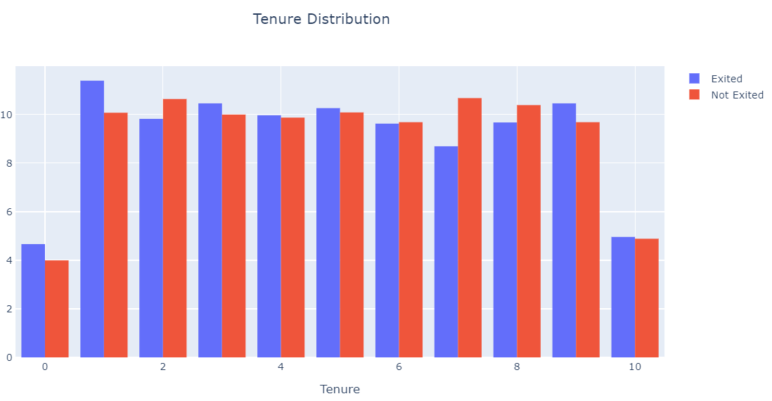
Data Exploration – Data visualization & analysis
👀 As observed above, the illustration of the graph shows that the number of exited and non-exited customers are almost the same in all range of Tenure and EstimatedSalary.

Slide 11
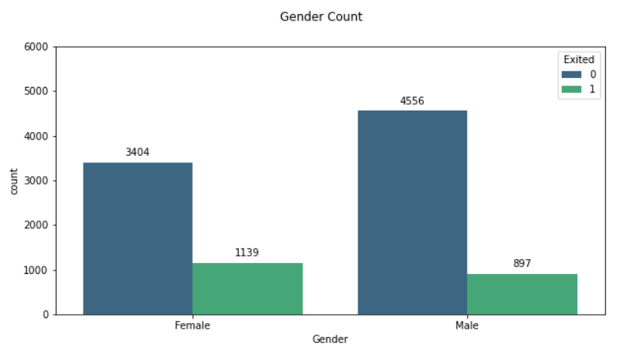
Data Exploration – Data visualization & analysis
👀 As observed, more female customers (55.94%) tend to leave the bank as compared to the number of male customers. Based on the gender proportion, a total of 25.07% female customers exited the bank within the female group while only 16.45% male customers exited the bank within the male group.

Slide 12
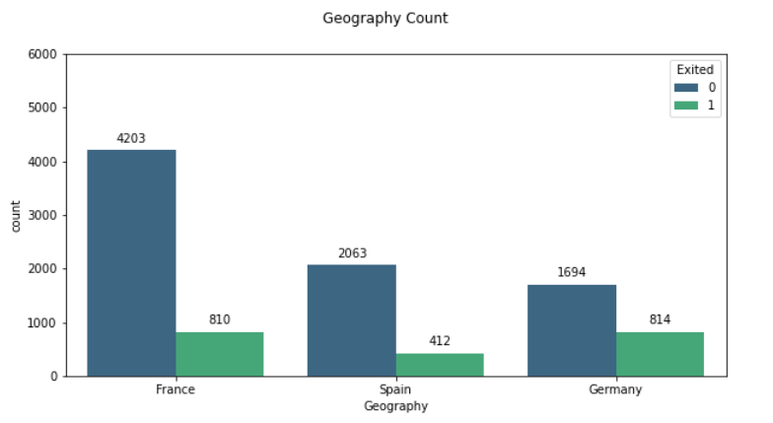
Data Exploration – Data visualization & analysis
👀 As observed, more German customers (39.98%) tend to leave the bank as compared to other countries, followed by France (39.78%) and Spain (20.24%) respectively. But based on the individual country's proportion, Germany still maintained the highest exited rate at 32.46%. However, for France and Spain, Spain has actually got more customers who exited the bank (16.65%) as compared to France (16.16%) within its own country.

Slide 13
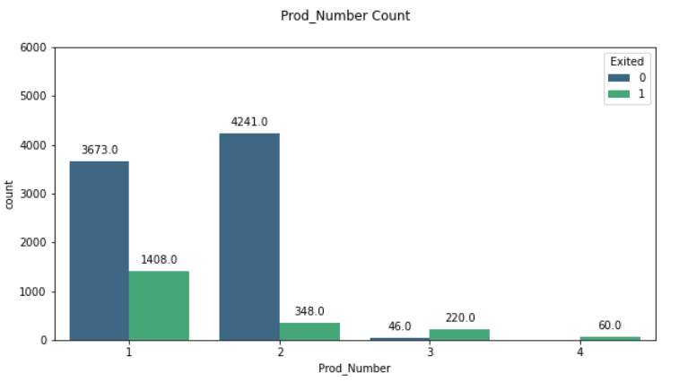
Data Exploration – Data visualization & analysis
👀 As observed, most customers who tend to leave the bank have one product (69.16%) while customers who have more than one product tend to stay with the bank especially those who have four products (2.95%). On the contrary, based on the individual grouping's proportion analysis, customers who have four products (100%) tend to leave the most, followed by customers who have three products (82.71%), one product (27.71%), and finally, customers who have two products (7.58%) with the bank.

Slide 14
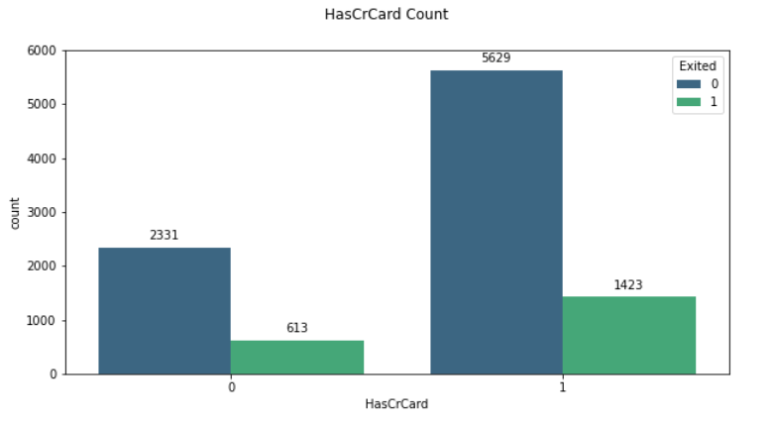
Data Exploration – Data visualization & analysis
👀 As observed, customers who have a credit card (69.89%) tend to leave the bank as compared to those who don't have it. Based on the grouping's proportion analysis, it shows the other way round, those customers who don't have a credit card with the bank (20.82%) tend to leave the bank instead of those who have a credit card with the bank (20.17%).

Slide 15
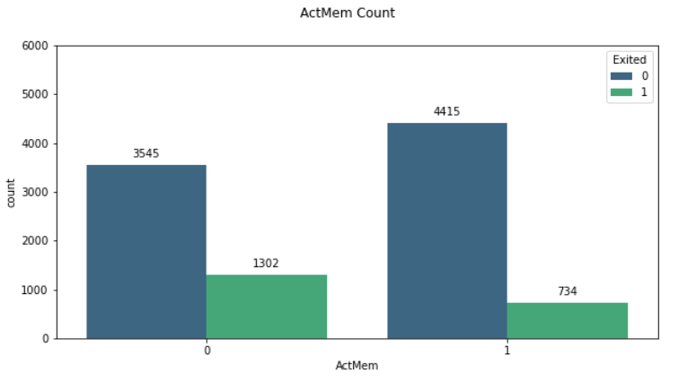
Data Exploration – Data visualization & analysis
👀 As observed, customers who are non-active members (63.95%) tend to leave the bank as compared to those who remained active. Similar results show in the grouping's proportion analysis as well.

Slide 16
Data Exploration – Summary
59.08% of exited customers are from ages 37 to 52 years old.
73.12% of exited customers are from zero savings (24.5%) and savings range between 97.5K to
147.5K(48.62%).
51.86% of exited customers have a credit score between 550 to 700.
63.95% of non-active members tend to exit from the bank.
Female customers tend to have a higher exited rate as compared to male customers.
Germany has more exited customers followed by Spain then France.
Customers who have 4 products tend to leave the most, followed by 3, 1, and finally 2 products.
Customers who don't have a credit card tend to leave the bank.

Slide 17
Modeling – Flow & process
In machine learning, classification is a supervised learning concept which basically categorizes a set of data into classes. In this project, our goal is to predict the probability of a customer is likely to churn or not to churn, therefore, we will use classification algorithms for this binary classification scenario.
Use K-fold cross validator to examine which best classifier algorithms to apply
Select top 2 classifier which generated best result, run a base model with the train set and evaluate on the test set
Use Sequential Feature Selector to choose the 'best' features for the model, based on the recall scoring
Build the model by the best parameters from Grid Search and new features selected by the Sequential Feature Selector.
Evaluate the performance by confusion matrix and roc_auc_score
Fit new features selected by the Sequential Feature Selector to the model and use Grid search algorithm to find optimal parameters.

Slide 18
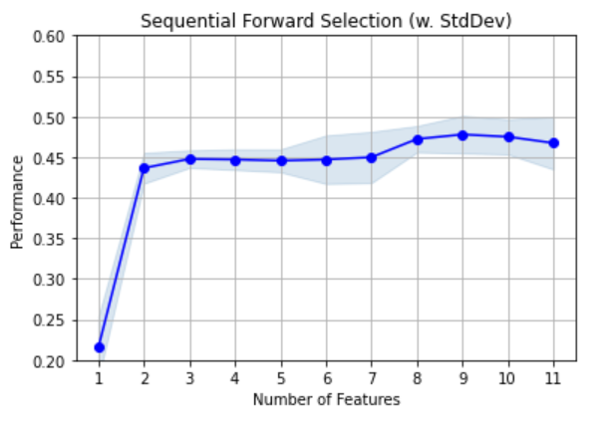
Modeling – Gradient boosting classifier’s SFS result
Selected Feature names: ('CredRate', 'Age', 'Balance', 'Prod_Number', 'HasCrCard', 'ActMem', 'Geography_Germany', 'Geography_Spain', 'Gender_Male’)
CV Score: 0.47789473684210526
👀 Observed that with 9 features the model will perform better, hence, will drop Tenure and Estimated Salary columns.

Slide 19
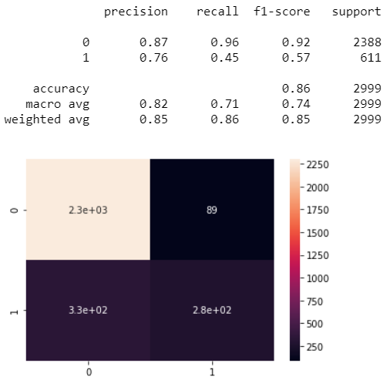
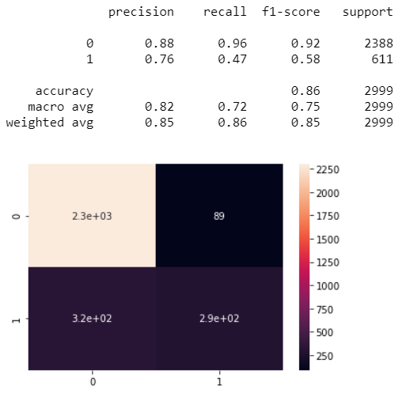
Modeling – Gradient boosting classifier confusion matrix result

Slide 20
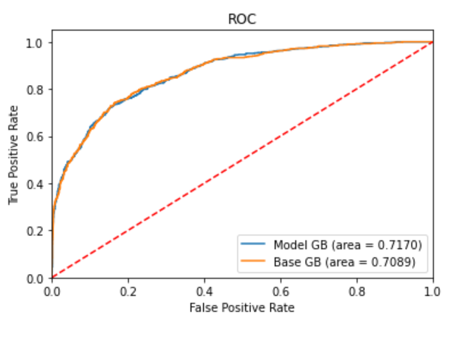
Modeling – Gradient boosting classifier’s roc_auc_score
👀 Improvement shown in Gradient Boosting Classification model as below :
Recall score improved from 45% to 47%
roc_auc_score improved from 70.89% to 71.70%

Slide 21
Modeling – Summary
The main objective of this project is to predict the probability of whether the customers are likely to churn or not so that the bank can put in necessary action to retain the customers. That is why the recall metrics score on the True positive cases (1 in recall score) are the most important in this scenario. It helps the bank to focus on spending their resources effectively towards the right target instead of wasting effort on the false-negative cases.
Given the results generated by both models, the gradient boosting classifier has derived a better recall score in this case. Besides, the data itself has only 20.37% of churned customer's records while the low CV score (47.79%) over the features of importance also increased the challenge to the model to predict more accurately. However, the model still managed to capture 47% of True-positive cases. The model also shows a 71.70% capacity to capture the true-positive rate against the false-positive rate in the roc_auc_score.
Since the CV score did not perform well, I suggest driving in more deeply in the feature engineering portion in the future if more time is allowed and more resources provided. It will definitely help the model to achieve better performance.

Slide 22

Questions
&
Answers

Slide 23
Thank you

